Slide 1

Use Case Realizations: sequence diagram
Design subsystems ➔ Package Diagram
Design classes ➔ Class Diagram
Use case realizations ➔ Sequence Diagram
Deployment diagram (implementation)

Slide 2
Interaction Diagrams: Realizing Use Cases and Defining Methods
Interaction diagrams are at the heart of object-oriented design
Realization of a use case:
  Determine what objects collaborate by sending messages to each other
Two types:
  Sequence (Our focus)
  Communication

Slide 3
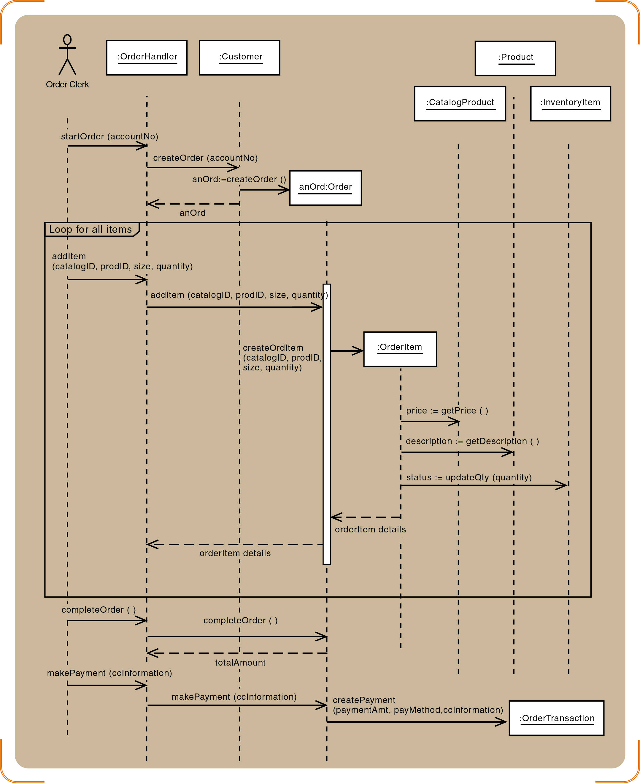
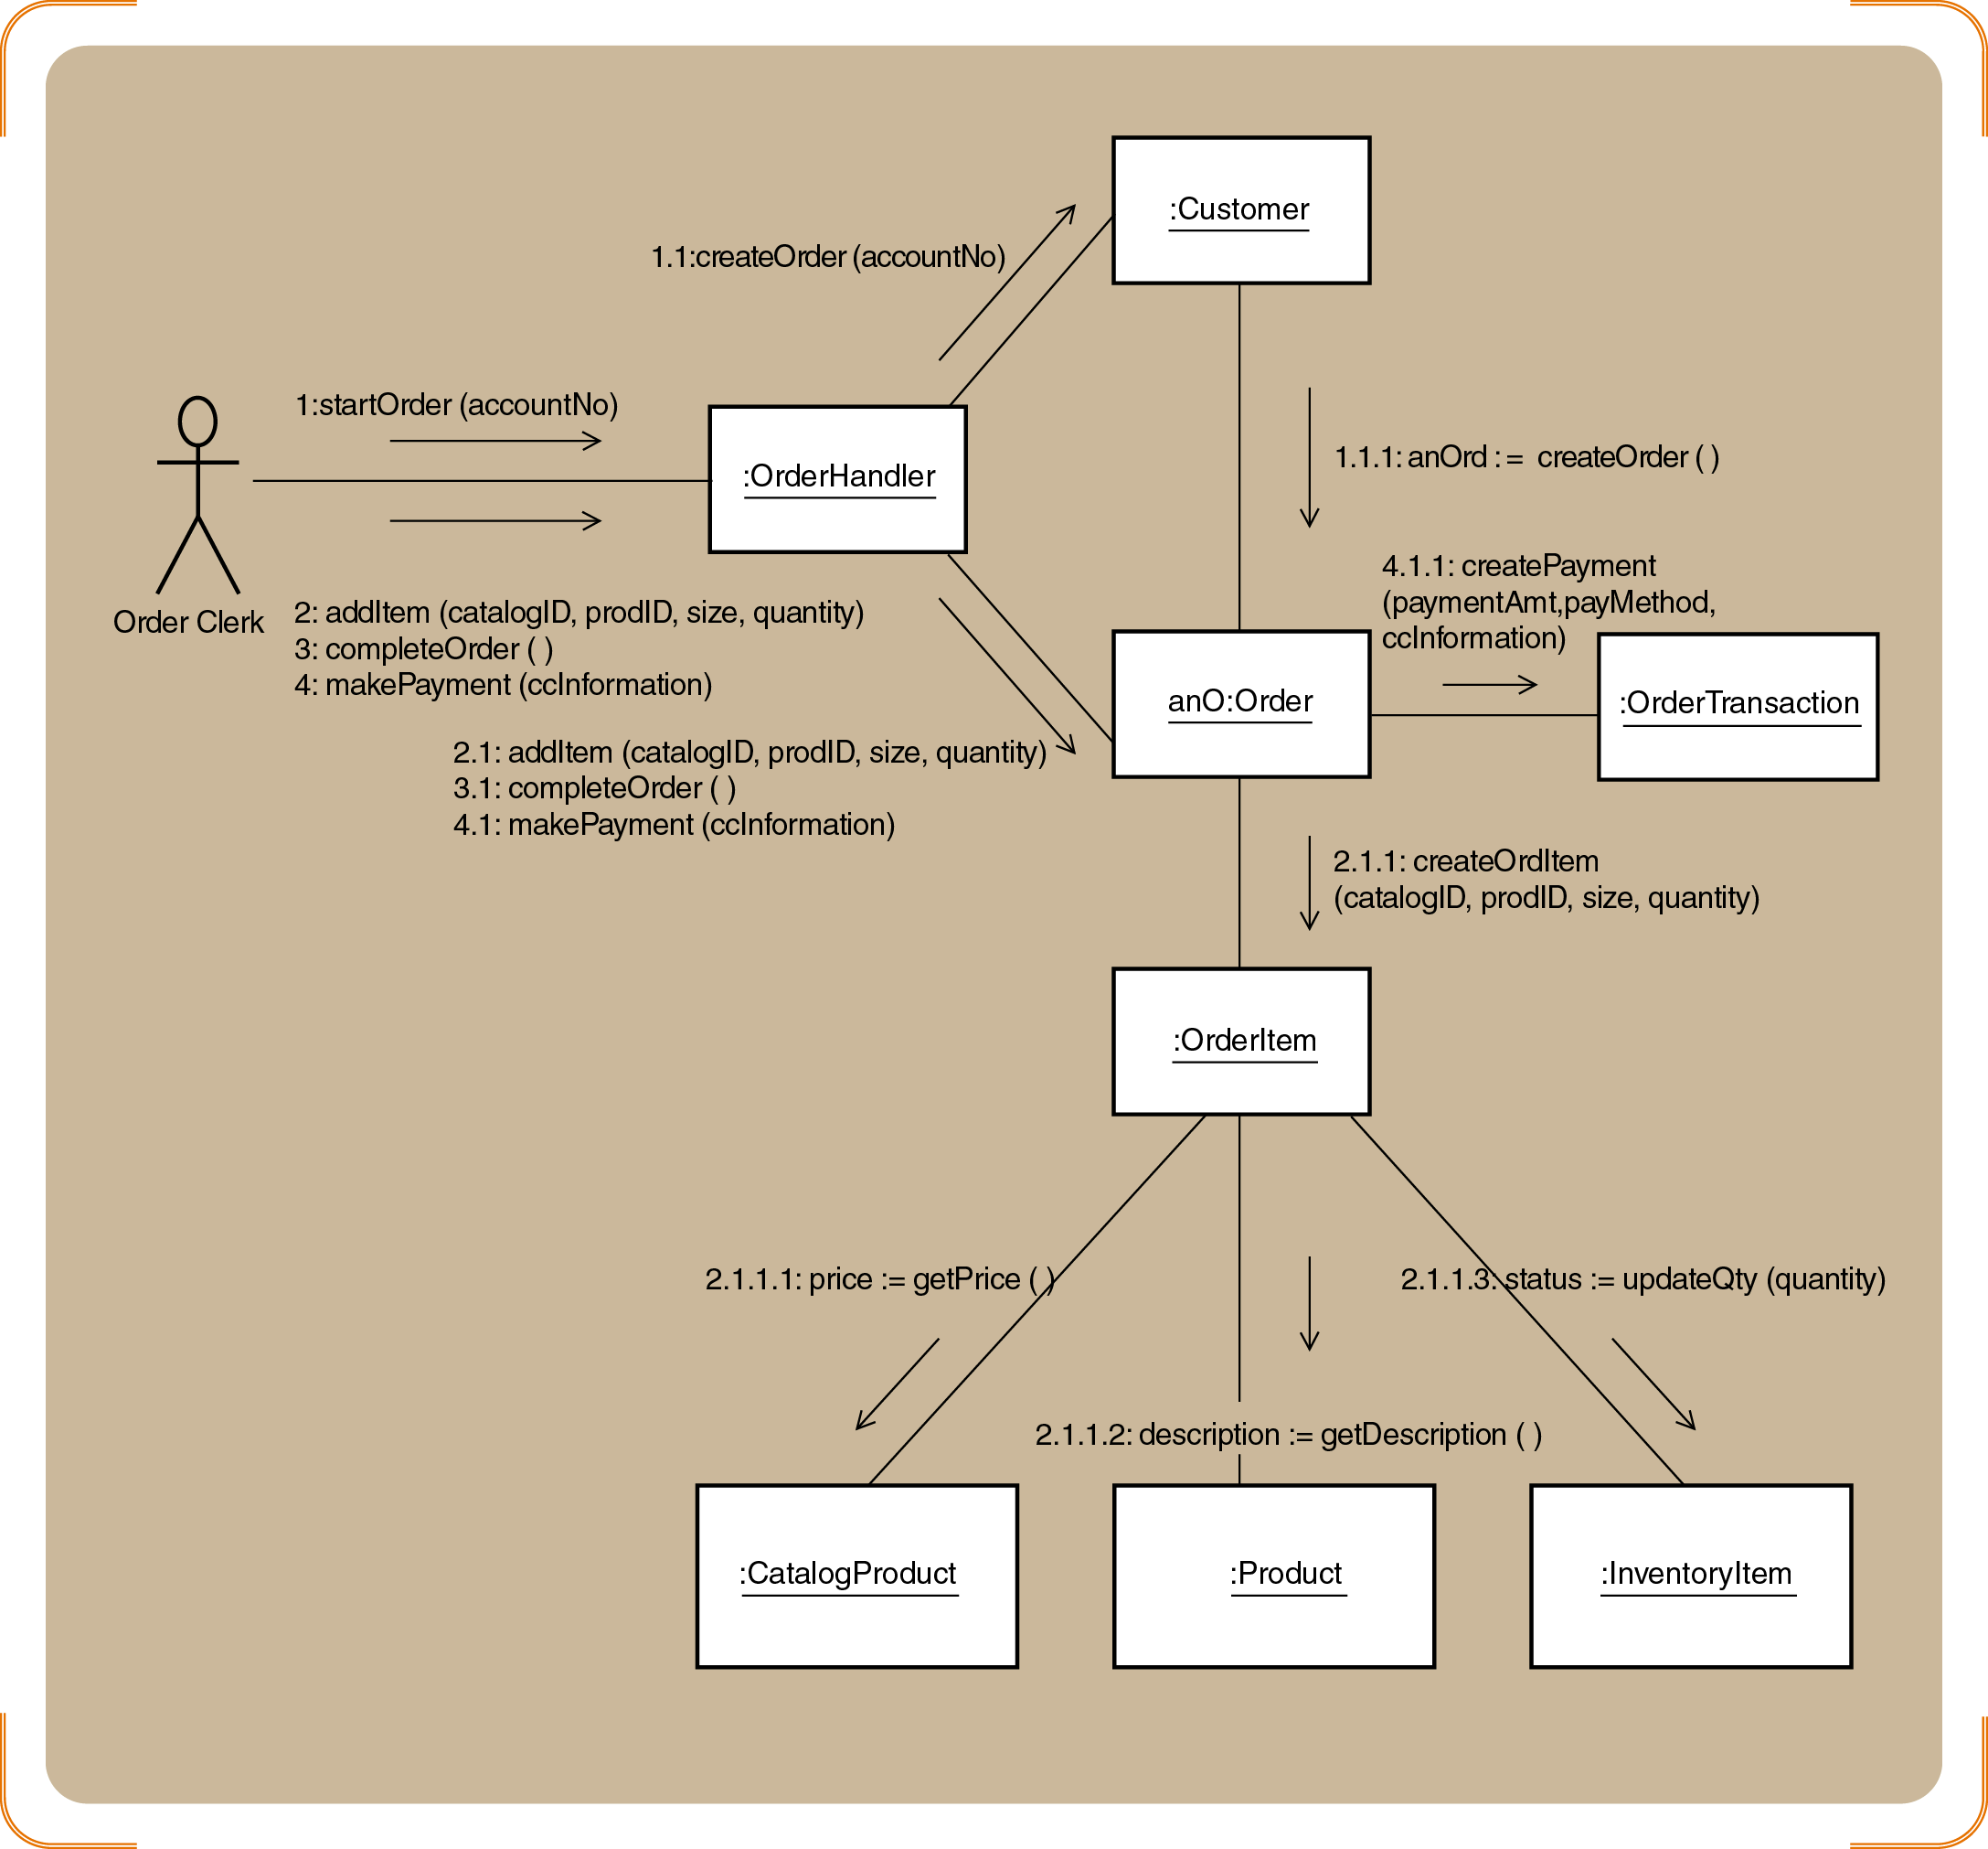
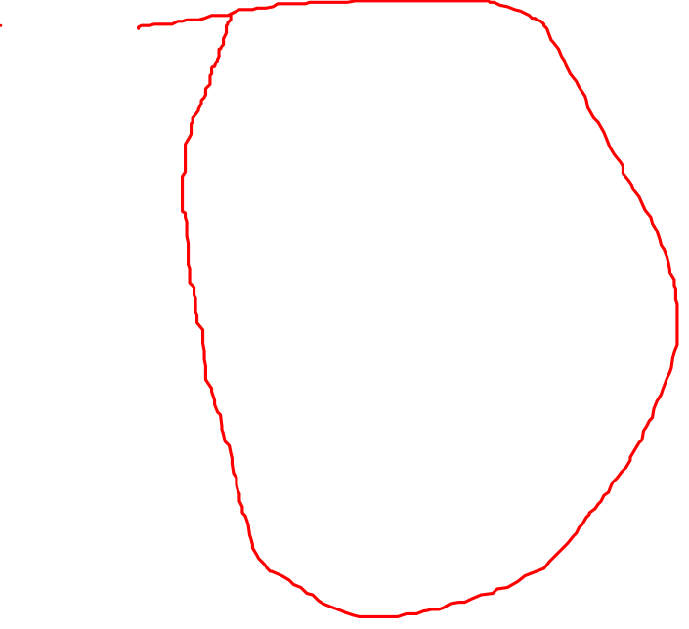
Interaction Diagrams: Sequence and Collaboration (will be elaborated in use case realization)
Our focus

Slide 4
Deployment diagram (implementation)
Design subsystems ➔ Package Diagram
Design classes ➔ Class Diagram
Use case realizations ➔ Sequence Diagram
Deployment diagram (implementation)

Slide 5
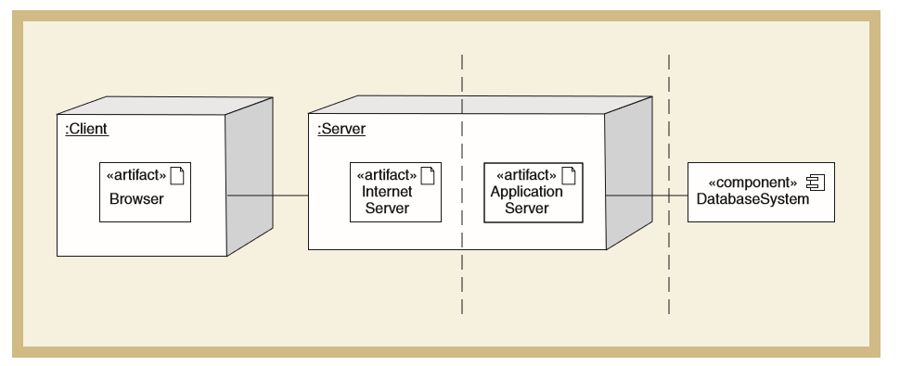
Example: Deployment Diagram for an Internet Based System
A deployment diagram shows the placement of various physical nodes (components) across different locations
A node can be thought of as a computer, or a bank of computers, representing a single computing resource
Satzinger (2011)

Slide 6
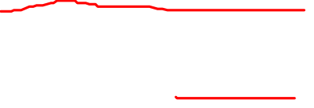
Component Diagrams vs.
Deployment Diagrams
Component Diagrams
Deployment Diagrams
Component diagrams focus on logical components
Component diagrams show the various executable components of the new system and how they relate to each other
deployment diagrams focus on physical components
Deployment diagrams show how and where the components are executed on various computing platforms. Together they define the system’s configuration

Slide 7
use case realization
Objective 4:

Slide 8
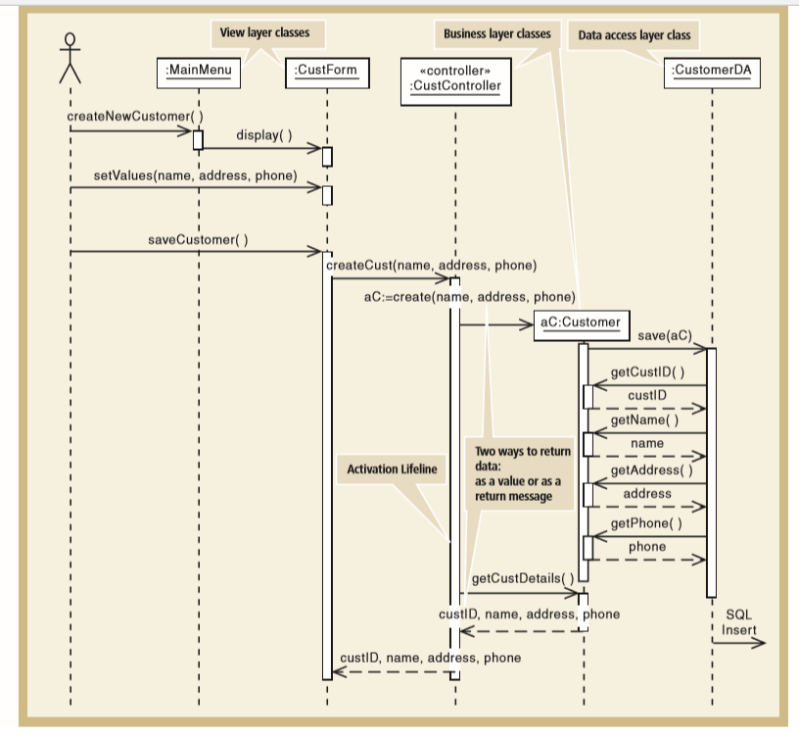
Use Case Realization: Example of a
Complete Design Sequence Diagram
View Layer Classes
MainMenu <<boundary>>
CusftForm <<boundary>>
Business Layer Classes
CustController <<control>>
Customer <<entity>>
Data Access Layer Classes
CustomerDA <<dataAccess>>
Satzinger (2011)

Slide 9
Steps for Use Case Realization:
Three Refinement Steps
Step 1: Add <<boundary>> classes in sequence diagram for View Layer (already done in analysis but can be added in design)
Step 2: Add <<control>> class in sequence diagram for Business Layer (already done in analysis but can be added in design)
Step 3: Add <<dataAccess>> class in sequence diagram for Data Access Layer

Slide 10
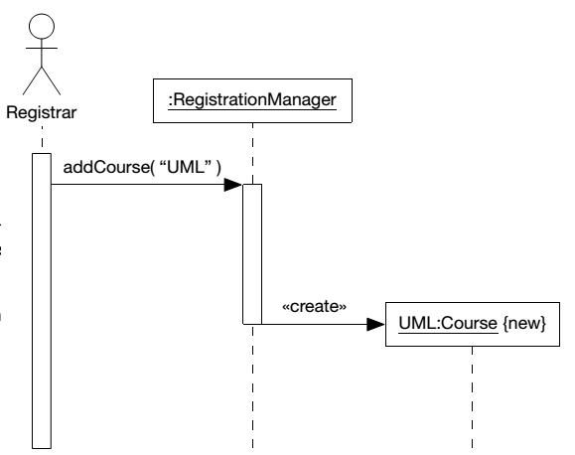
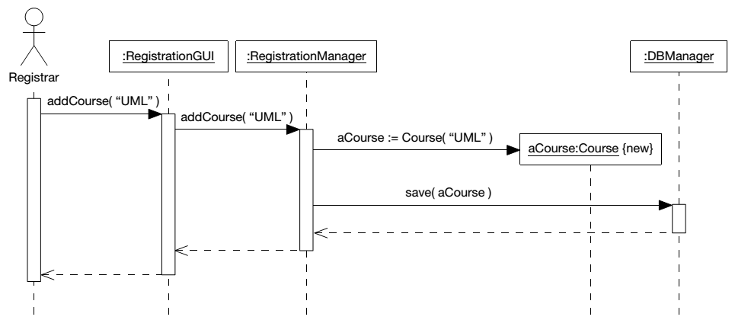
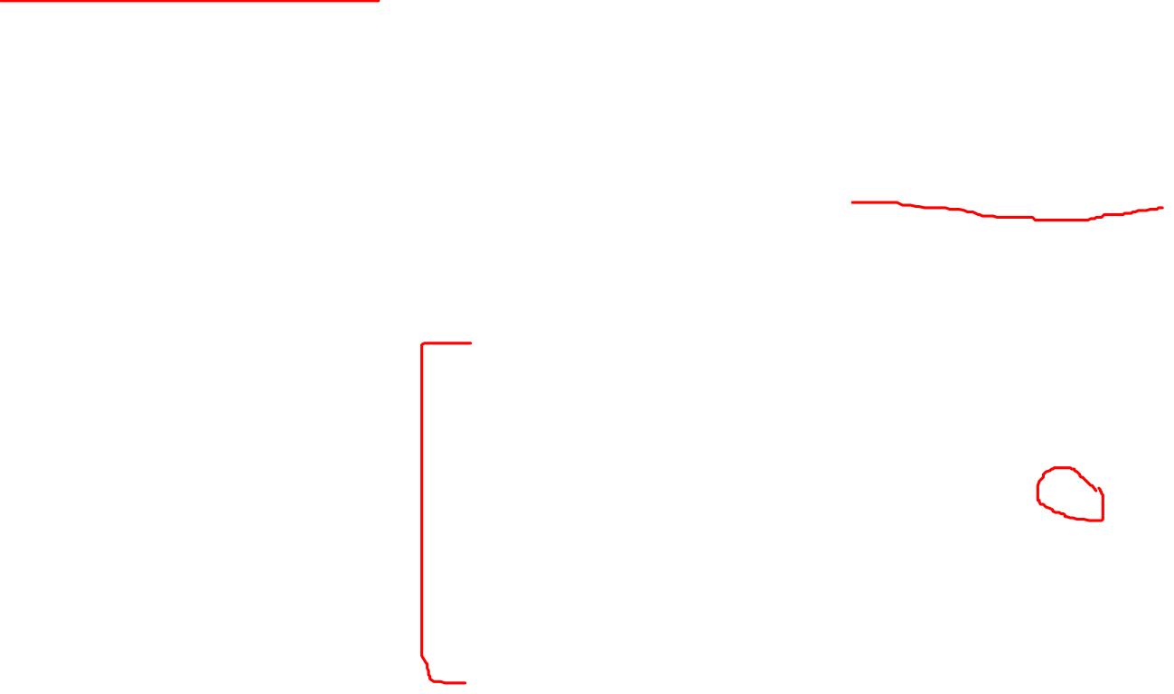
Step 1: Add <<boundary>> classes in sequence diagram
- GUI layer has been added
- Object construction is also shown by an explicit constructor method invocation.
Source: Arlow and Neustadt (2002)

Slide 11
Step 2: Add <<control>> class in sequence diagram
An artifact invented by the designer to handle a system function
  Serves as a collection point for incoming messages
  Intermediary between the outside world and the internal system

Slide 12
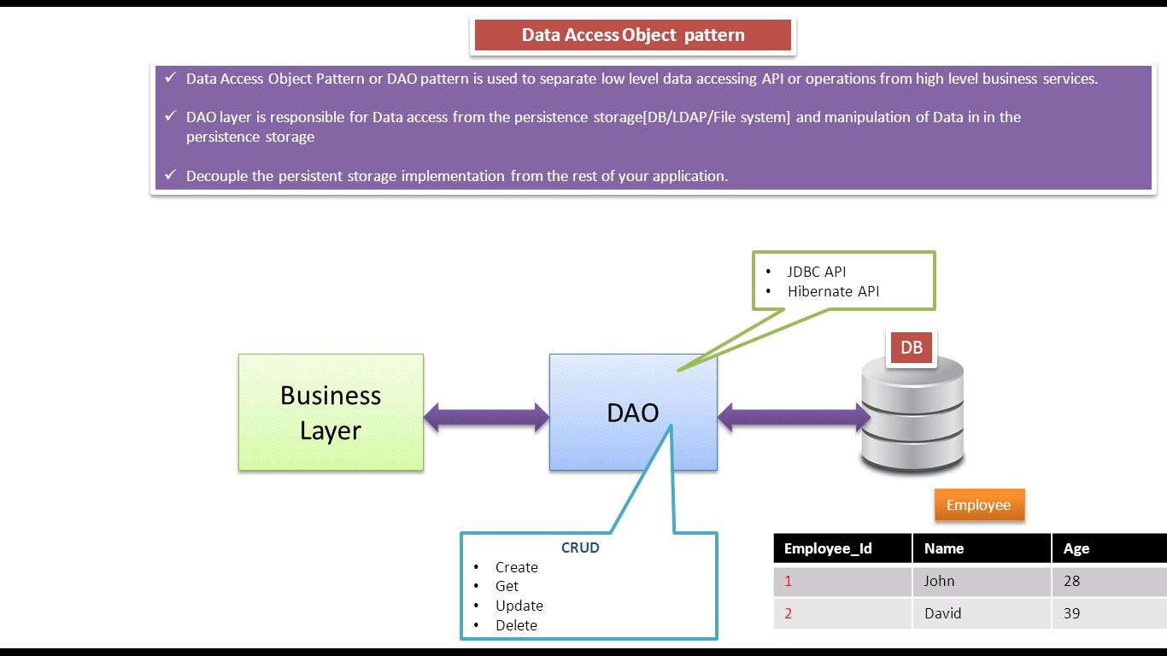

Step 3: Add <<dataAccess>> class in sequence diagram
*Note: Example of implementation:
- Cloud database without sql such as Firebase
- JDBC
Source: https://ramj2ee.blogspot.my/2013/08/data-access-object-design-pattern-or.html#.WtrBjIhuaDJ

Slide 13
Example: Sequence Diagram for Telephone Order
Define a user controller object
Define a “create” message for new Order objects
  Customer object creates the Order object
Define other messages
  addItem, createOrdItem, getDescription, getPrice, updateQty
Identify source, destination, and navigation visibility for each message

Slide 14
Developing a Multilayer Design for the Telephone Order Scenario
Extend one message at a time
View layer
  Open Order window and return a Customer object
Data layer
  Customer object initializes itself
  Add items to an order with a repeating message
  Save Order and OrderItem to the database
  Update database inventory
  Complete transaction

Slide 15

Sequence diagram with <<control>> and <<entity>> classes only for Telephone Order scenario

Slide 16
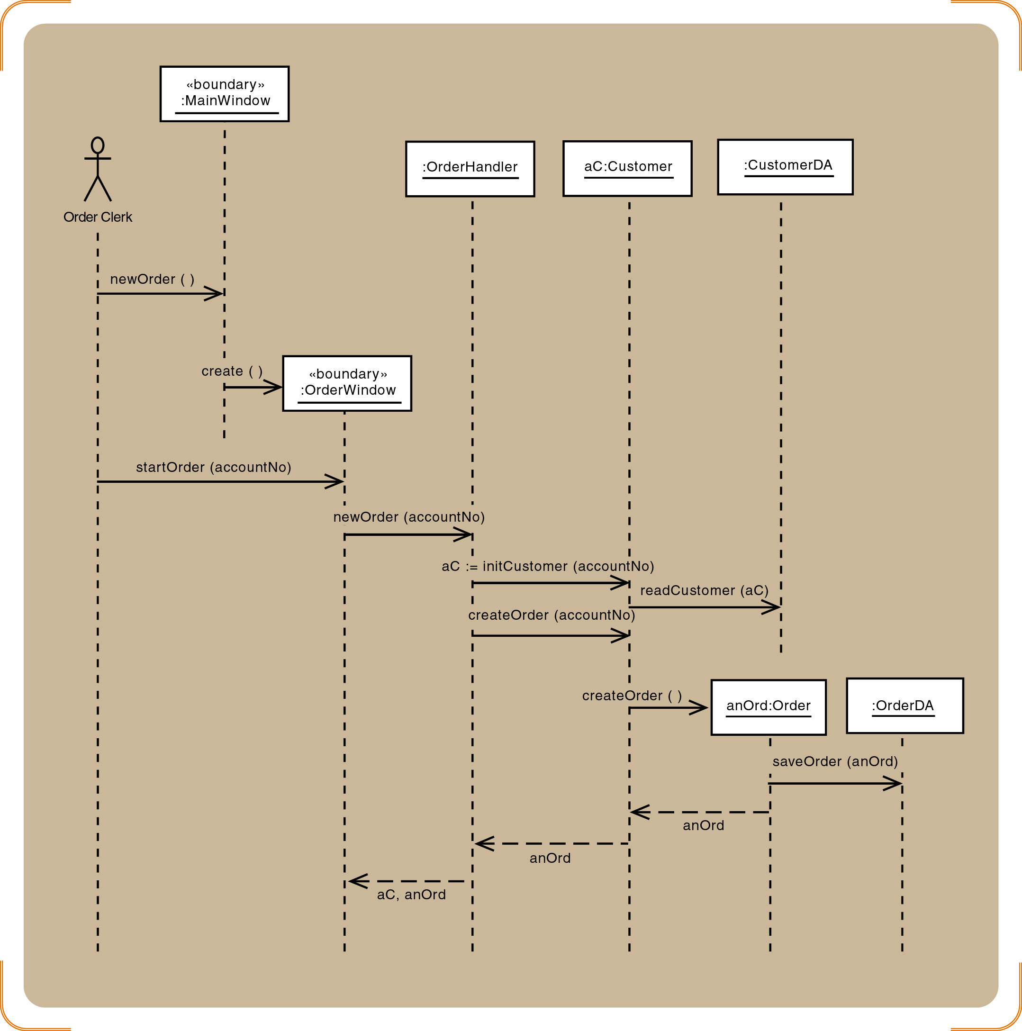
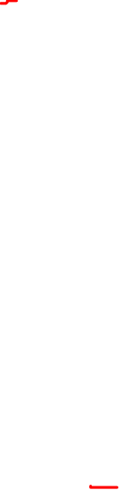
Telephone order sequence diagram for newOrder and startOrder messages - <<boundary>> and <<dataAccess>> classes are added

Slide 17
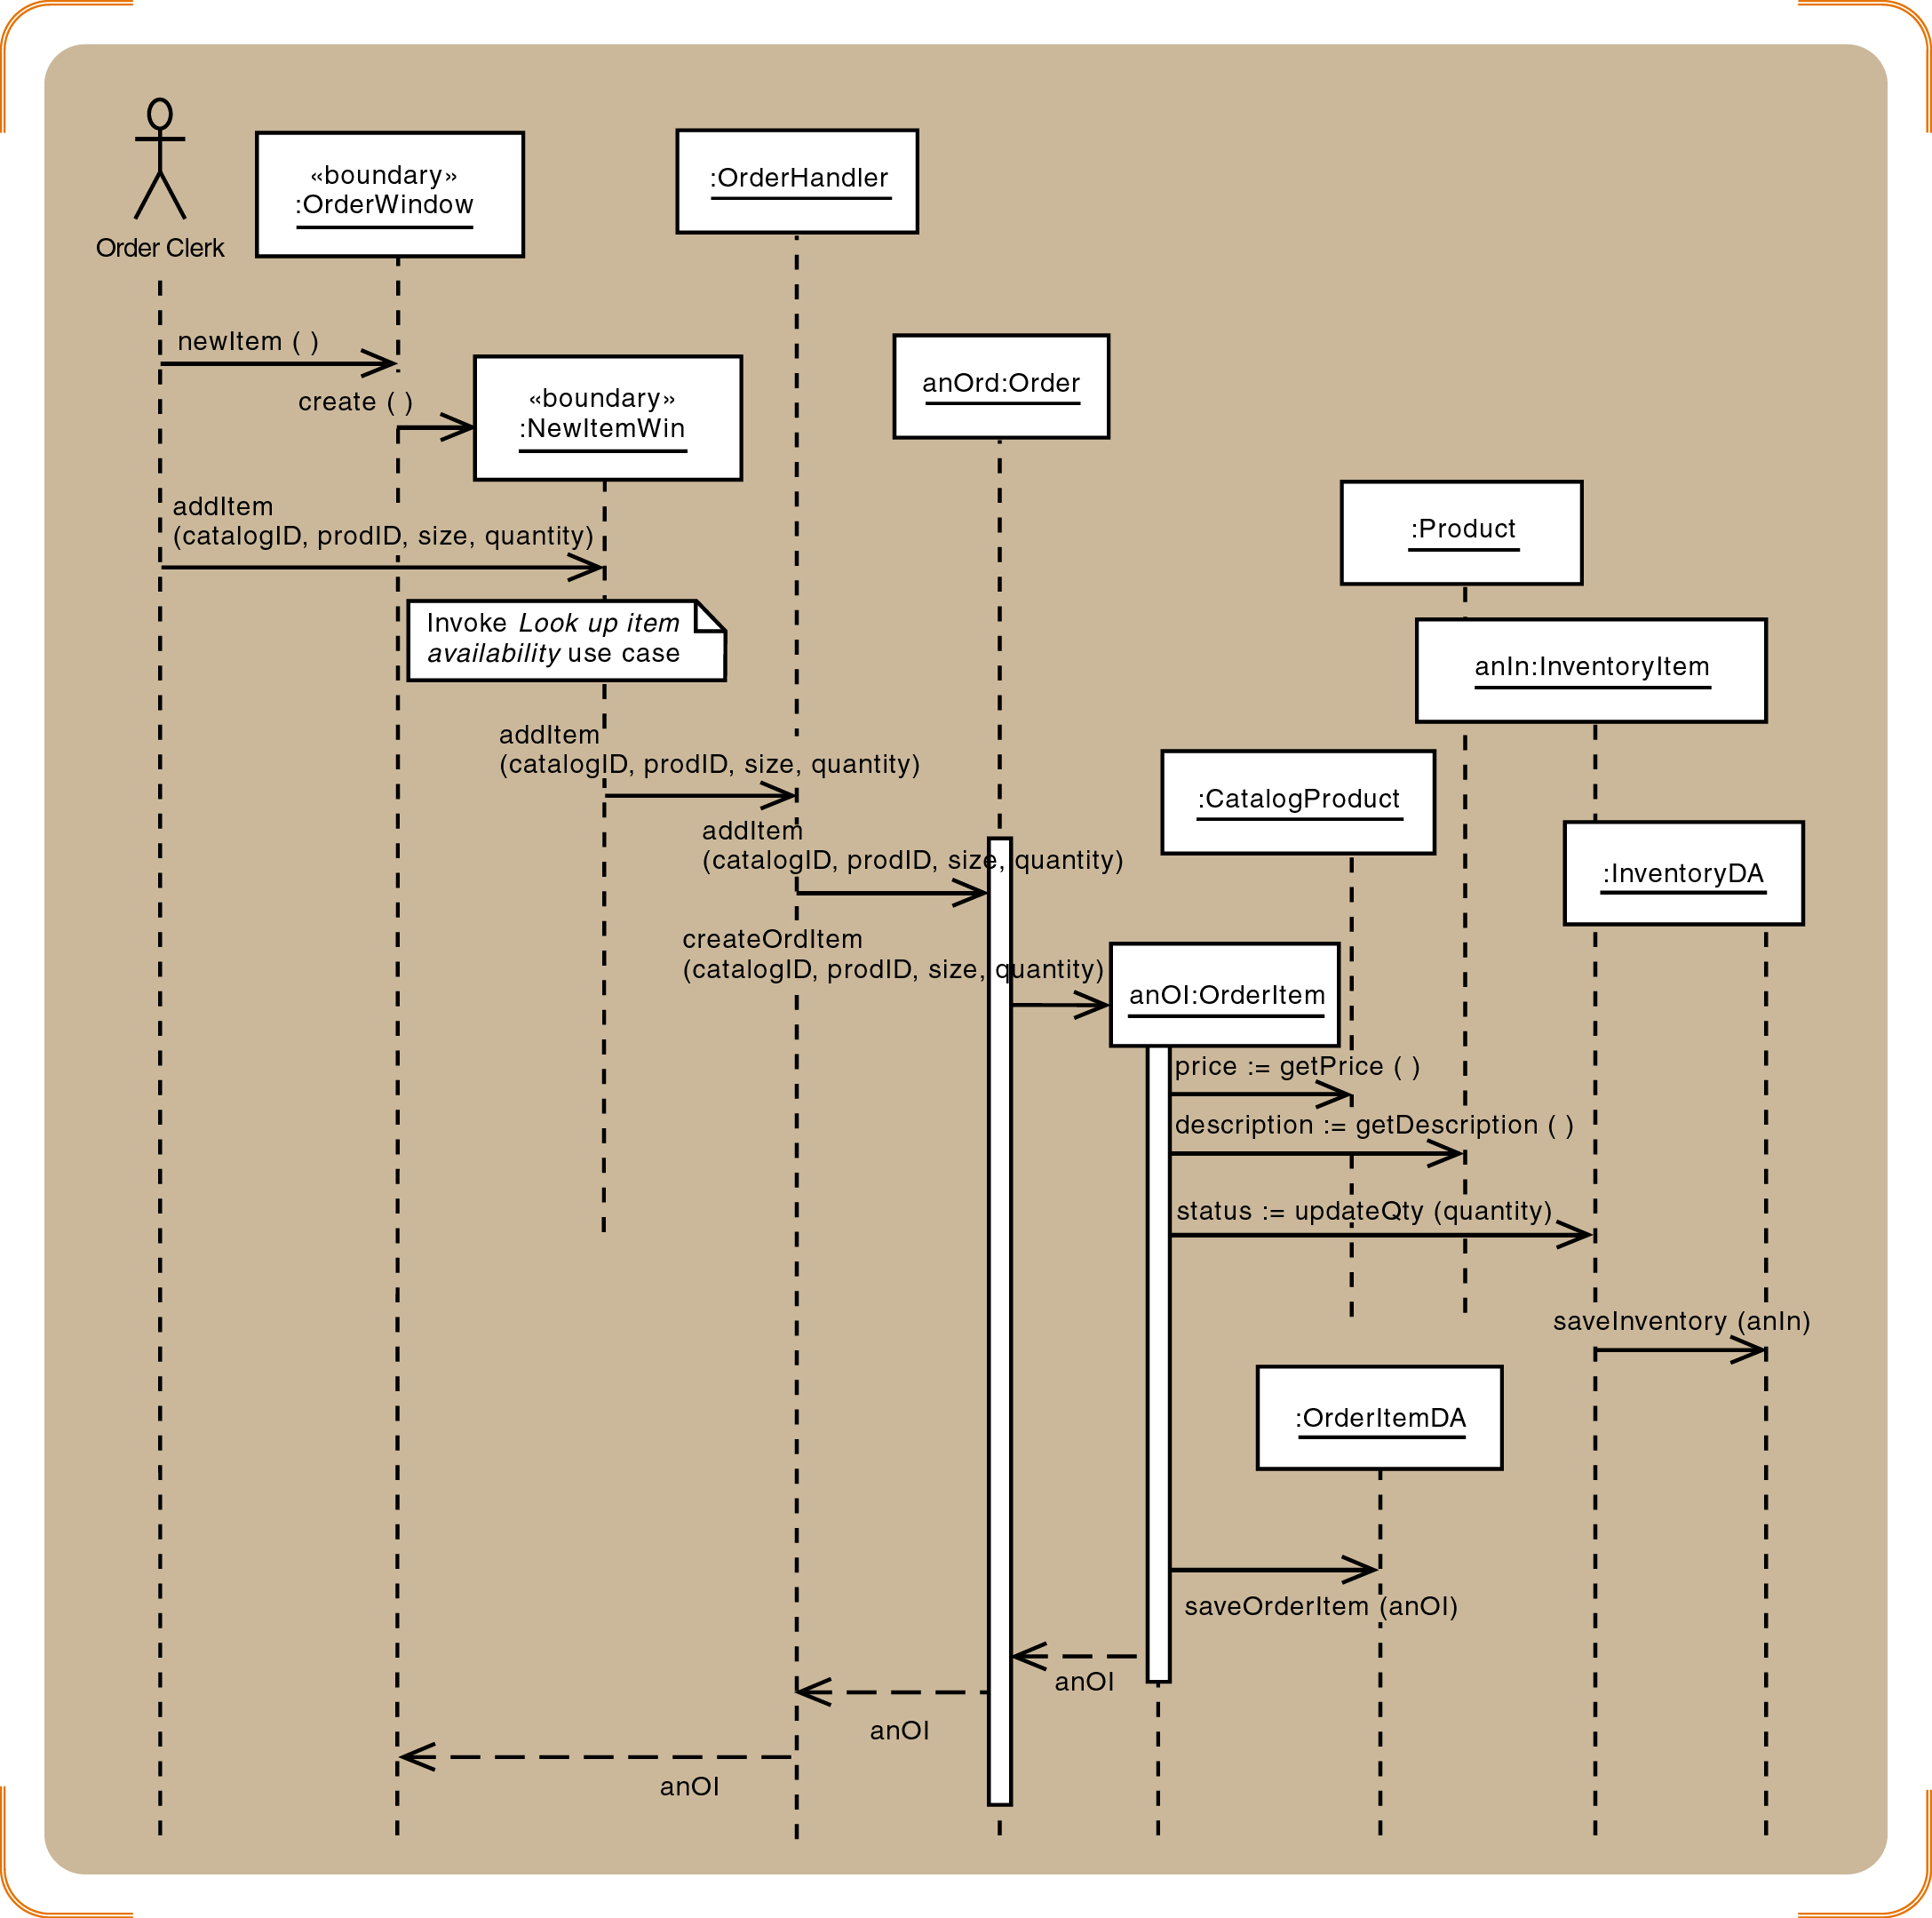
Telephone order sequence diagram for newItem and addItem messages - <<boundary>> and <<dataAccess>> classes are added

Slide 18
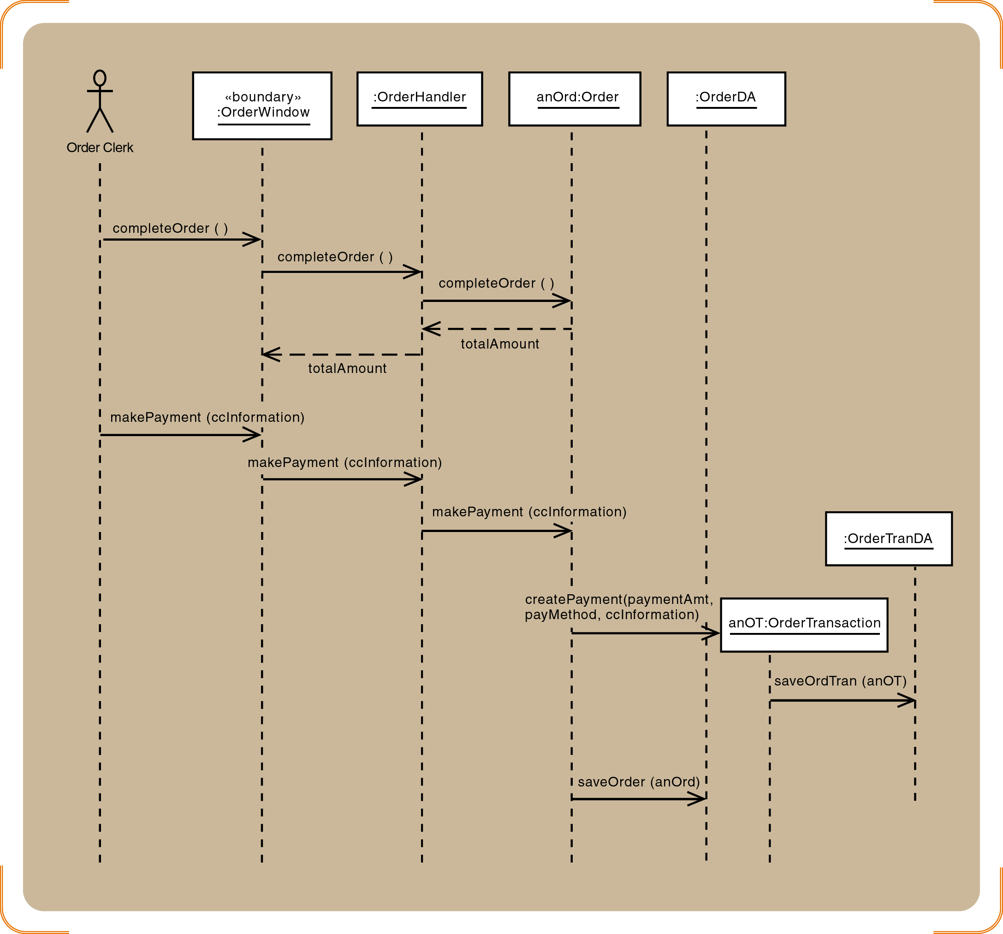
Telephone order sequence diagram for the final messages (complete Order and makePayment) - <<boundary>> and <<dataAccess>> classes are added

Slide 19
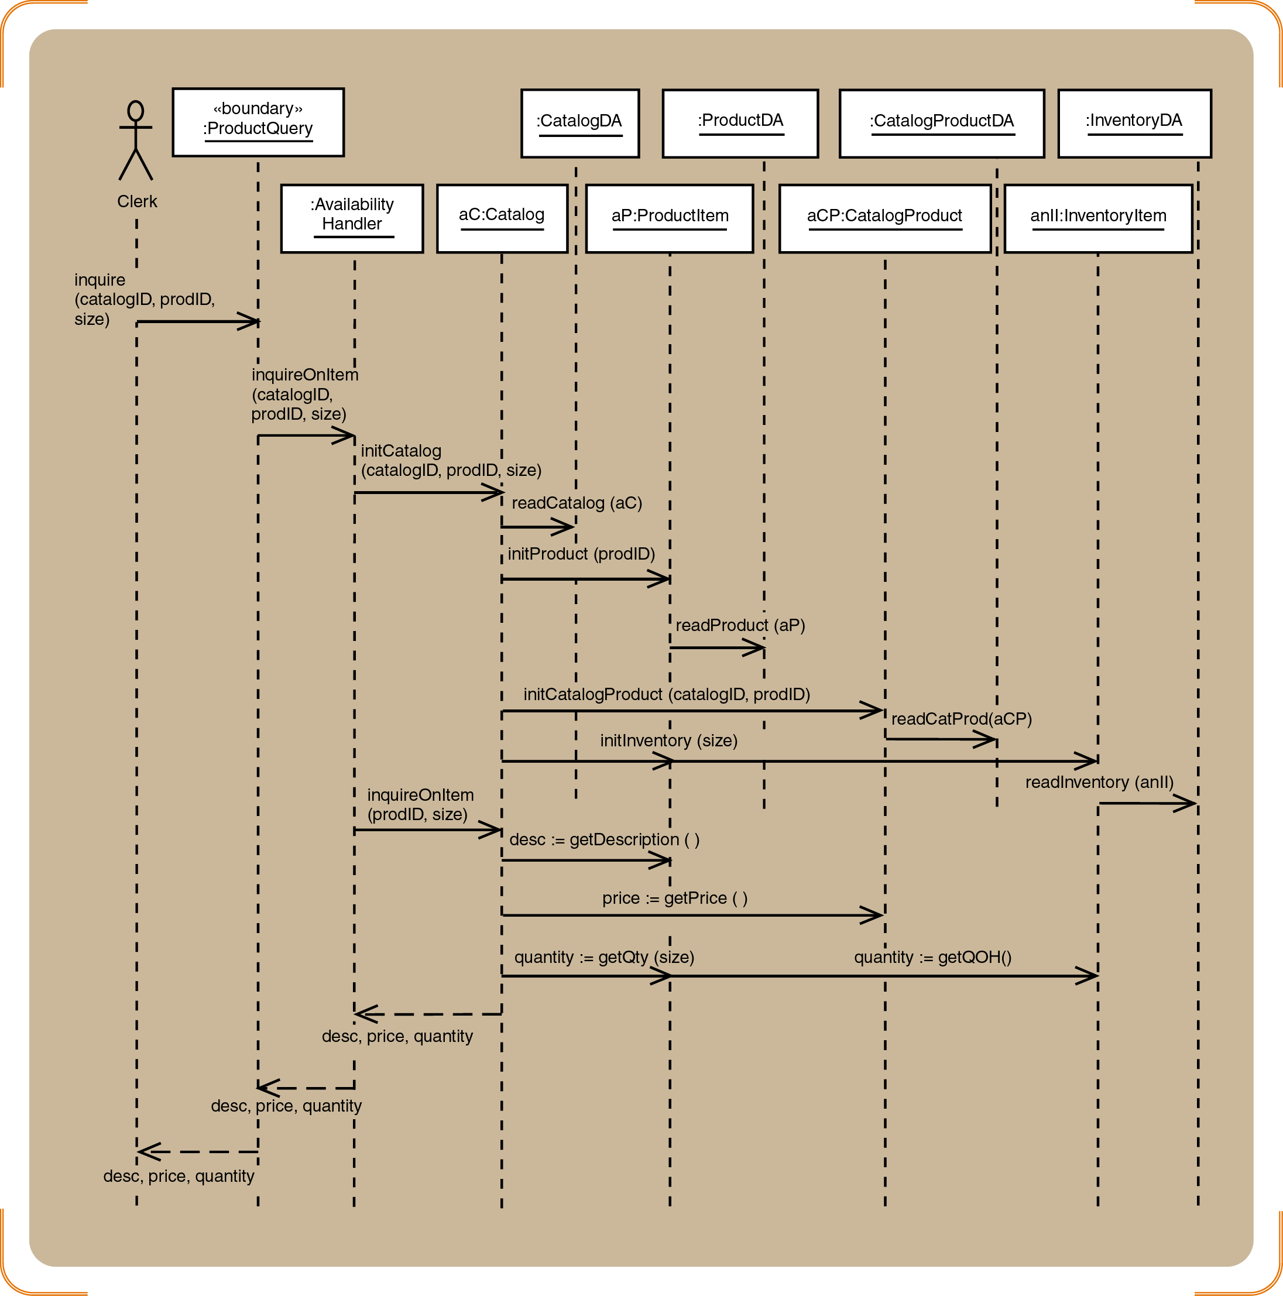
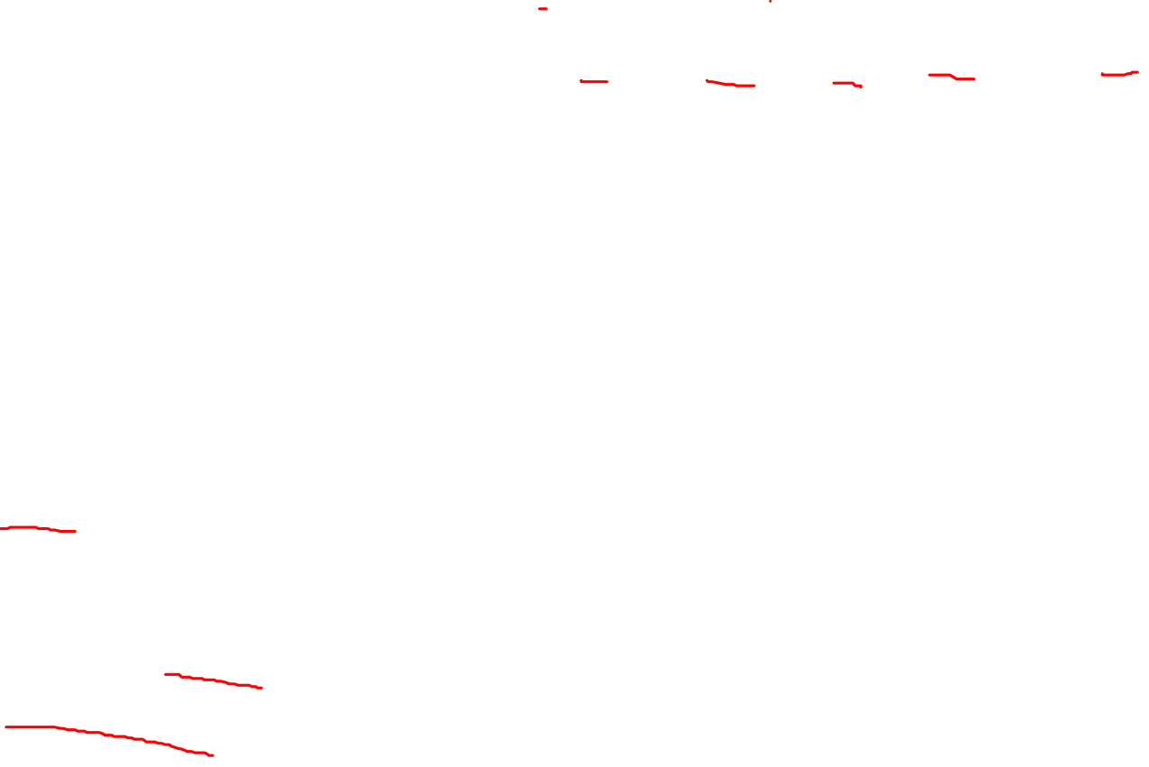
Design sequence diagram after the 3 refinement steps
Example: Completed three-layer design that includes <<boundary>>, <<control>>, <<entity>> and <<dataAccess>> classes for Look up item availability scenario

